Slide 1


Data Science

Slide 2


Slide 3
Topics today
Our Daily job
Experimentation (A/B Testing, …) Machine Learning
Self Service Analytics
„Agile“ Analytics
Insights Sharing

Slide 4
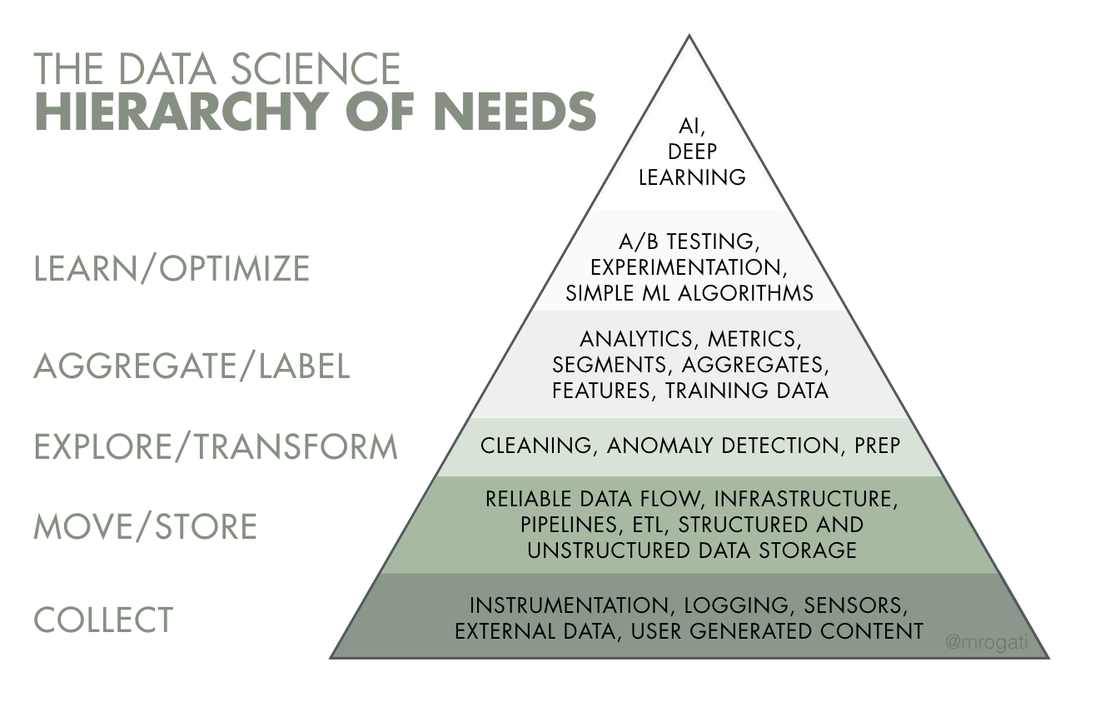
Source: Monica Rogati’s Medium post “The AI Hierarchy of Needs”

Slide 7
The A/B Testing Process
1. Define your experiment
Treatment
How do you measure success? Set a metric.
2. Randomly assign users to control group and treatment group
3. Go live: expose users
4. Once sample size is reached, analyze collected data

Slide 8
What is the most important feature we have released in 2019?

Slide 9
What is this?

Slide 10
Insights Sharing
Knowledge Repo
Flex Dashboard
GitHub

Slide 11

Thank you

